Slide 1
Power BI Dashboard: Super Store Sales & Profit Insights

Slide 2
Objective & Overview
Goal: Analyze sales and profit data from the Superstore dataset using Power BI to create actionable insights for decision-making.
Key Deliverables:
Data Cleaning & Transformation
Key Visualizations
Dashboard Design
Business Insights & Recommendations
Dataset Used: Superstore Sales Dataset

Slide 3
Dataset Summary
Data Structure:
Order Details: Order ID, Order Date, Ship Date
Customer Details: Customer Name, Customer Segment
Product Information: Category, Sub-Category, Product Name
Sales Metrics: Sales Amount, Profit, Discount, Quantity
Geographical Data: Region, State
Data Preparation: Handled missing values Removed duplicate records Ensured correct data types

Slide 4
Key Performance Indicators (KPIs)
Metrics Tracked:
Total Sales – Measures overall revenue. Total Profit – Indicates profitability. Total Quantity Sold – Highlights demand and product performance.
Visuals: KPI Cards in Power BI showcasing these metrics.
Insights:
Total revenue trends over time.
Profitability relative to sales.
High-demand products and categories.

Slide 5
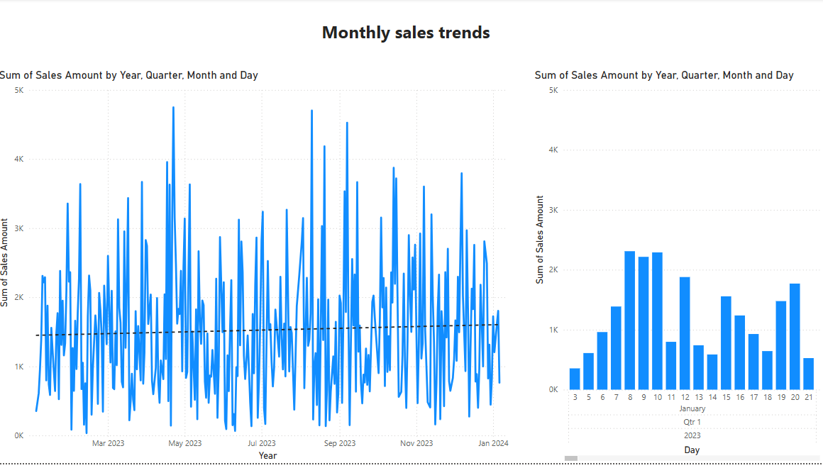
Sales Trends & Regional Insights
Monthly Sales Trends:
Visualization: Line chart showing sales fluctuations over time.
Insight: Identifies peak sales months and potential seasonal trends.

Slide 6
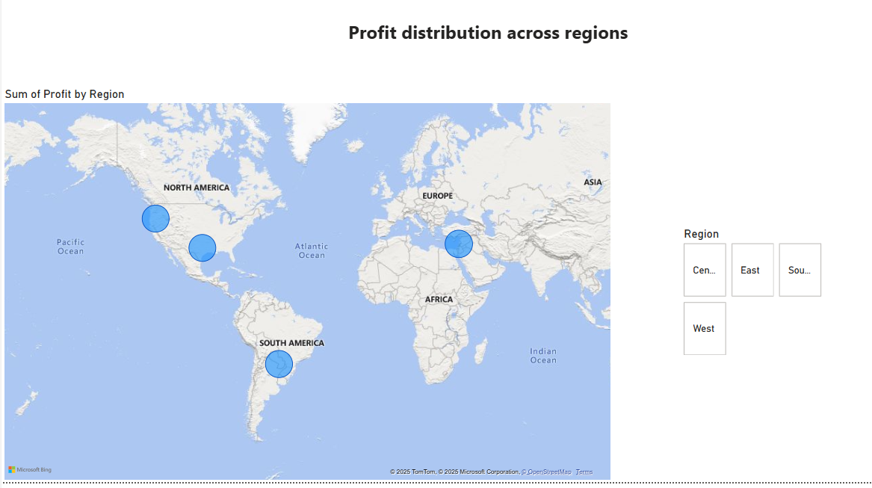
Profit Distribution by Region:
Visualization: Map displaying regional profit variations.
Insight: Highlights the most and least profitable regions.

Slide 7
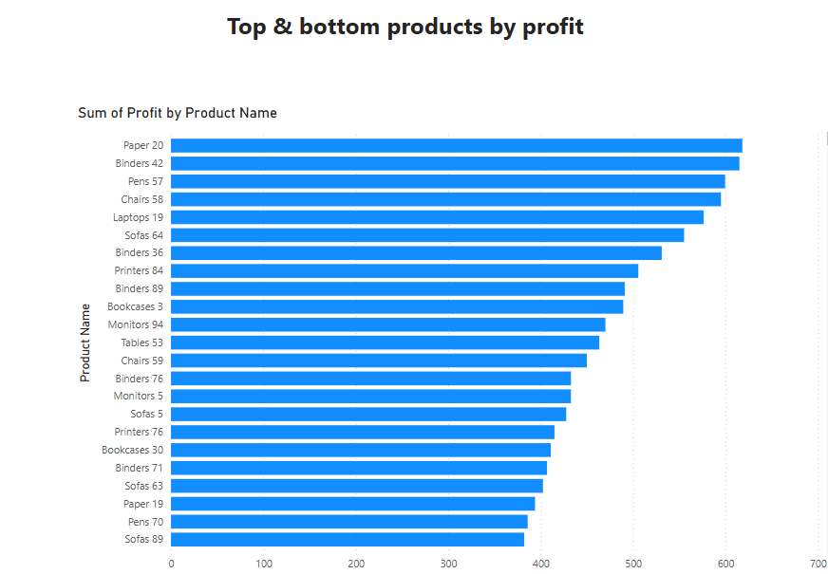
Top & Bottom Products by Profit:
Visualization: Bar chart ranking the most and least profitable products.
Insight: Guides inventory and marketing strategies.

Slide 8
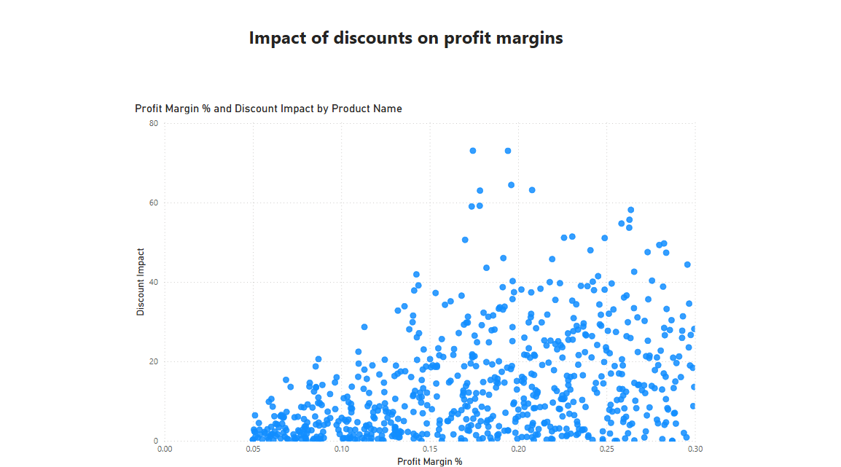
Discount Impact on Profitability
Visualization: Scatter plot showing discount percentage vs. profit.
Insight: Helps determine the optimal discount range to maximize profit.
Key Takeaway: Higher discounts don’t always translate to higher profitability.

Slide 9
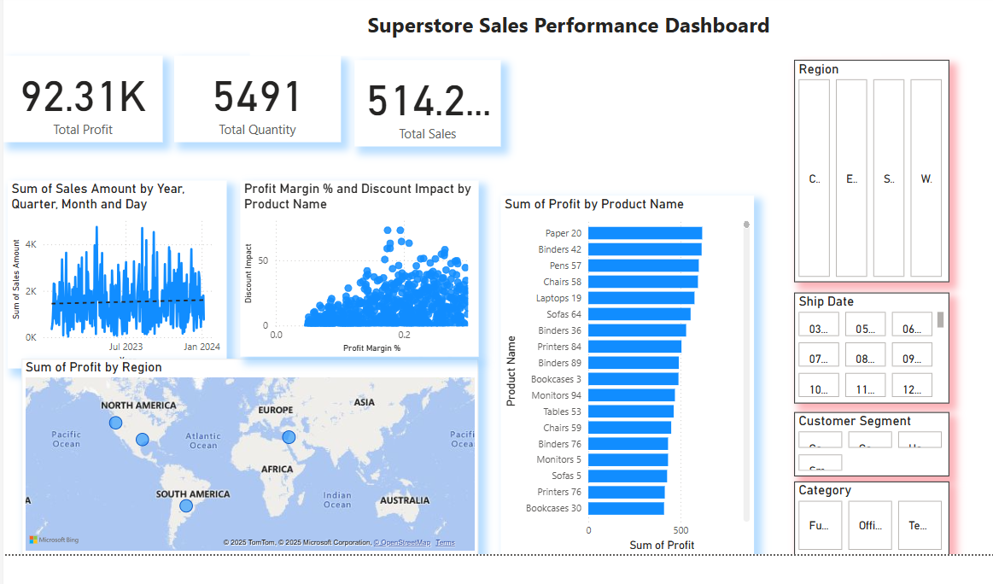
Super Store Sales Performance Dashboard
Dashboard Features:
Interactive Filters – Drill down by date, region, customer segment, and product category. Drill-Through Capabilities – Enables deeper analysis. User-Friendly Interface – Designed for quick decision-making.
Screenshot of the Power BI Dashboard showcasing all key metrics and trends.

Slide 10
Key Insights & Business Recommendations
Findings:
Region A leads in sales, while Region X underperforms.
Certain categories (e.g., Electronics & Furniture) consistently perform well.
Some products benefit from discounts, while others show no correlation.
Actionable Recommendations: Strengthen marketing efforts in high-performing regions. Revise pricing and discount strategies to maximize profit margins. Boost visibility and promotions for underperforming products.

Slide 11
Conclusion
This Power BI dashboard provides valuable insights into sales trends, profit distribution, and product performance.
The interactive features allow for data-driven decision-making, helping optimize sales strategies.
Further deep dives can explore underperforming products, customer behavior, and regional market trends.

